Slide 1
Mechanisms of Ultrasound-induced Changes in Brain Rhythms and Connectivity
Session: Ultrasound for Neuromodulation
Saturday February 1, 2025
3:35 PM – 3:50 PM

Slide 2
Mechanisms of Ultrasound-induced Changes in Brain Rhythms and Connectivity
Jacek Dmochowski, PhD
Department of Biomedical Engineering
City College of New York

Slide 3
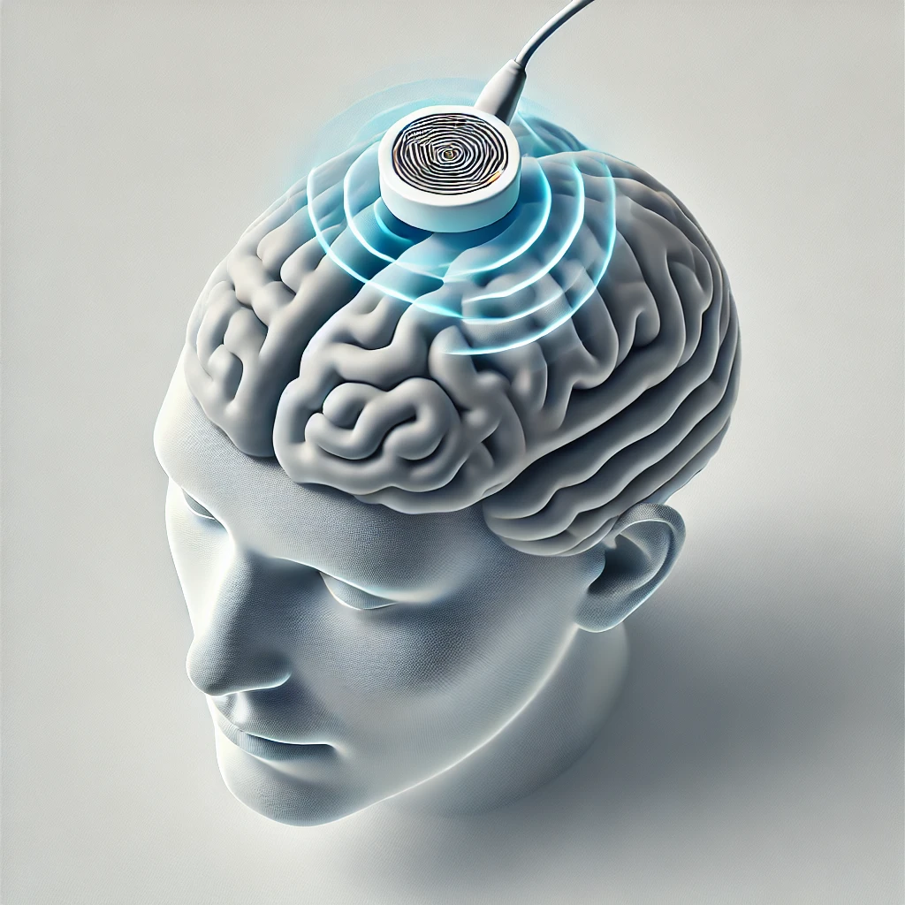
What is ultrasonic neuromodulation?
Candidate mechanisms
Heat
Cavitation
Membrane capacitance
Membrane permeability
Mechanosensitive ion channels
Flexoelectricity
Astrocytes
Blackmore Ultrasound Med. Biol. 2019
Kamimura Front. Phys. 2020
Dell'Italia Front. human neurosci. 2022

Slide 4
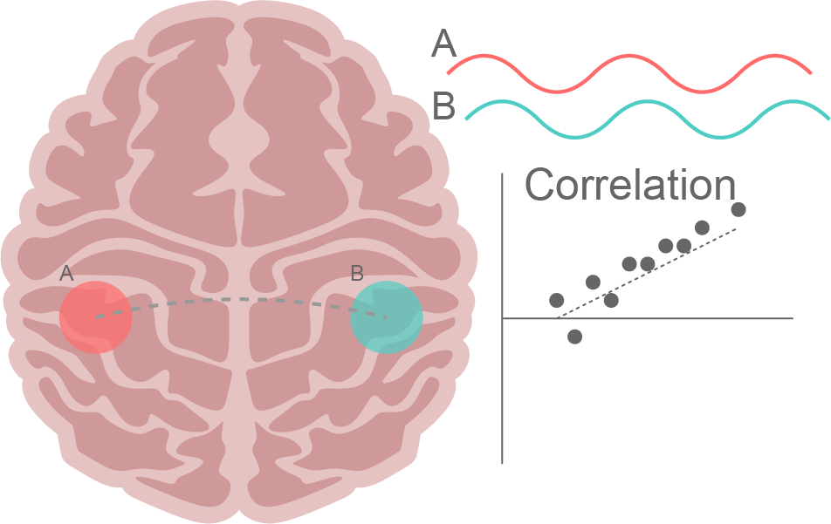
What is functional connectivity?
Correlation of signals from distinct regions of the brain
Often measured with functional magnetic resonance imaging (fMRI) in the resting state
Associated with brain state, clinical phenotype
Rogers Magn. Reson. Imaging 2007
Van Den Heuvel ENP 2010

Slide 5
What is known about FUS and functional connectivity?
FUS increases connectivity
FUS reduces connectivity
Chou Brain Stim. 2024* (human)
Verhagen eLife 2019 (monkey, offline)
Yaakub Nat. Commun. 2023 (human)
* Some connections strengthen, some weaken
Chou Brain Stim. 2024* (human)
Lord Front. Hum. Neurosci. 2024 (human)
Kuhn Front. Neural Circuits 2023 (human)
Zhang Brain Sci 2021
Sanguinetti Front. Hum. Neurosci. 2020 (human)
Meng Neuroimage 2019 (human Alzheimer BBB)
Todd Neuroimage 2018 (rat)

Slide 6
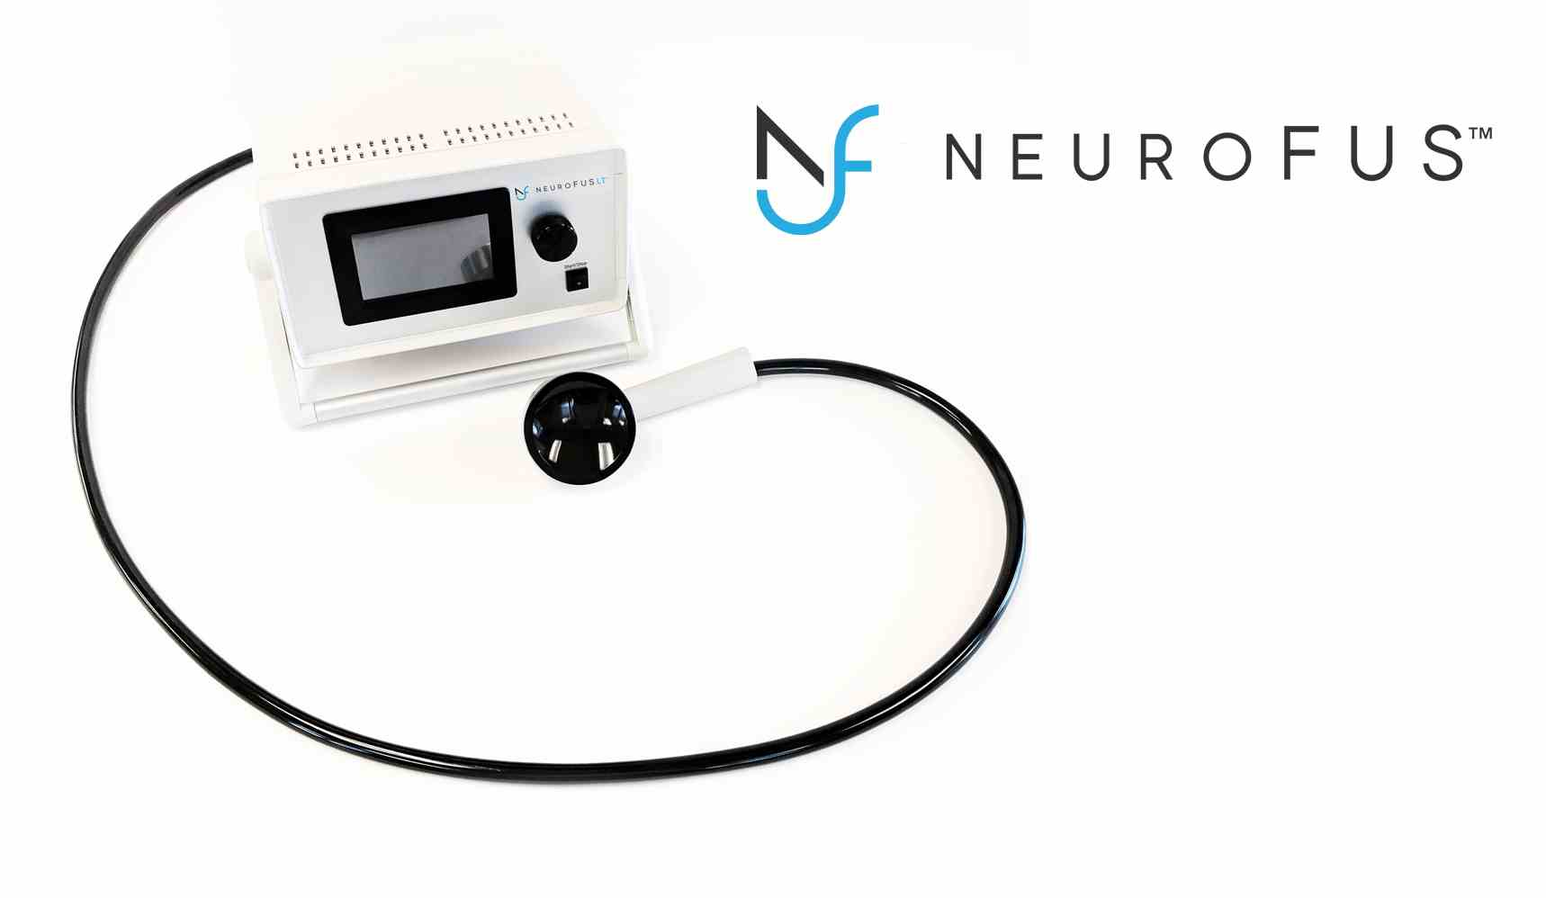
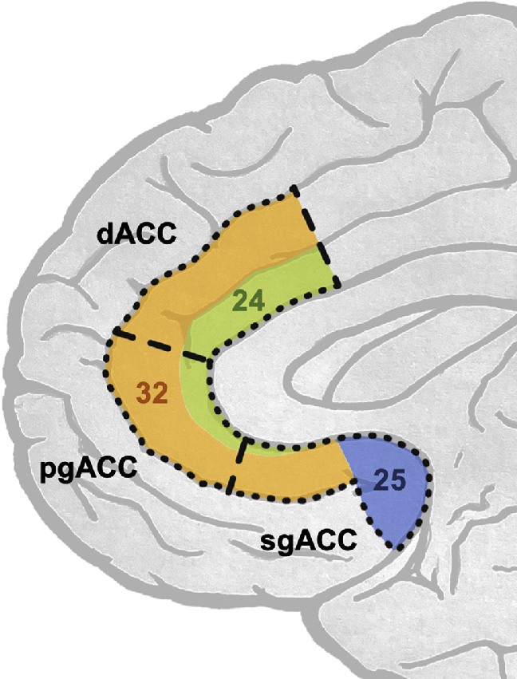
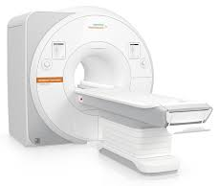
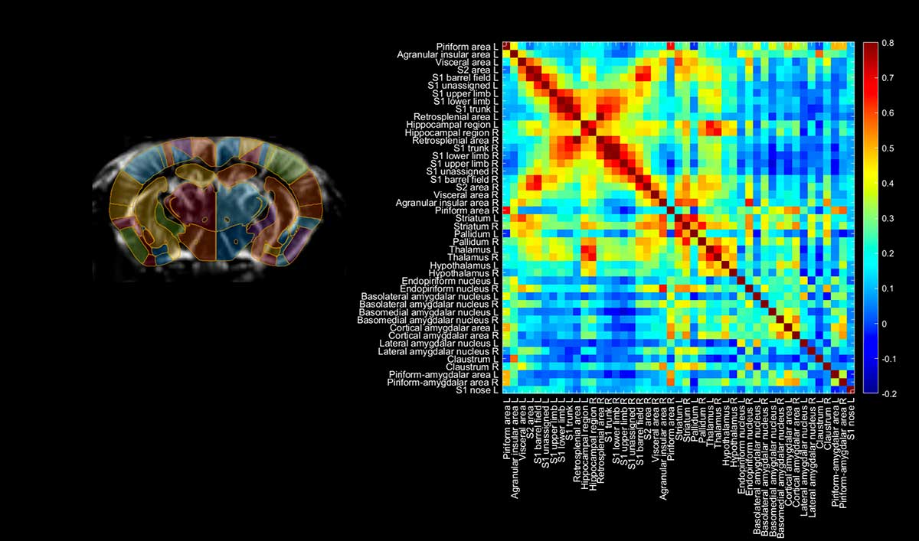
Experimental question
Can tFUS reliably modulate the activity of a clinically-relevant, deep brain region ?
tFUS
Subgenual cingulate
fMRI BOLD
Functional Connectivity
Target

Slide 7
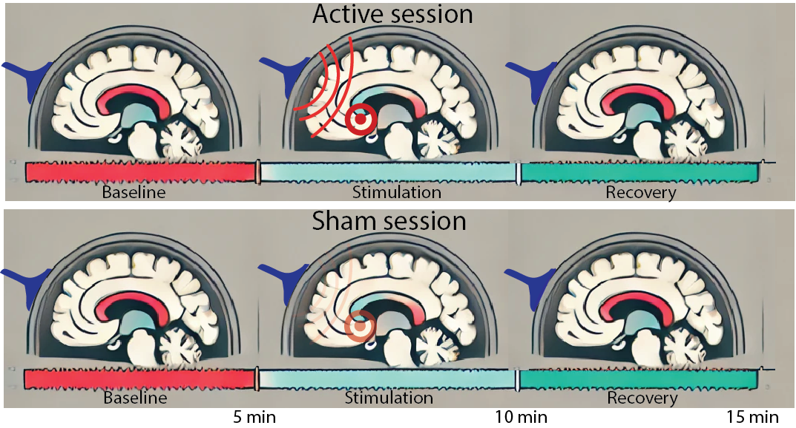
Our experiments
N=16 healthy human adults (within-subjects, active/sham)
FUS: 0.5 MHz, I_{spta} = 667 mW/cm², 5 x 20 s with 40 s ISI
Target: subgenual anterior cingulate (sgACC)
Outcome measure: fMRI BOLD functional connectivity with target

Slide 8
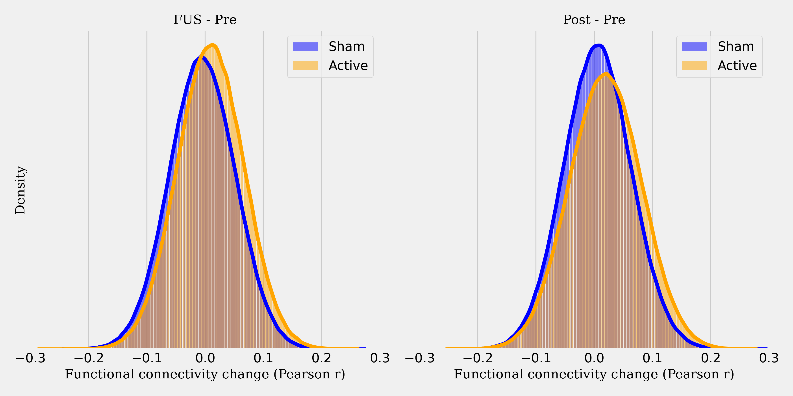
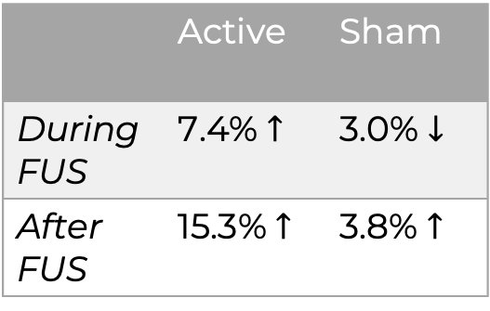
Brain-wide connectivity tends to increase
Change in FC during stimulation
Change in FC after stimulation
Mean effect size
 | Active | Sham
During FUS | 7.4% $↑$ | 3.0% $↓$
After FUS | 15.3% $↑$ | 3.8% $↑$

Slide 9
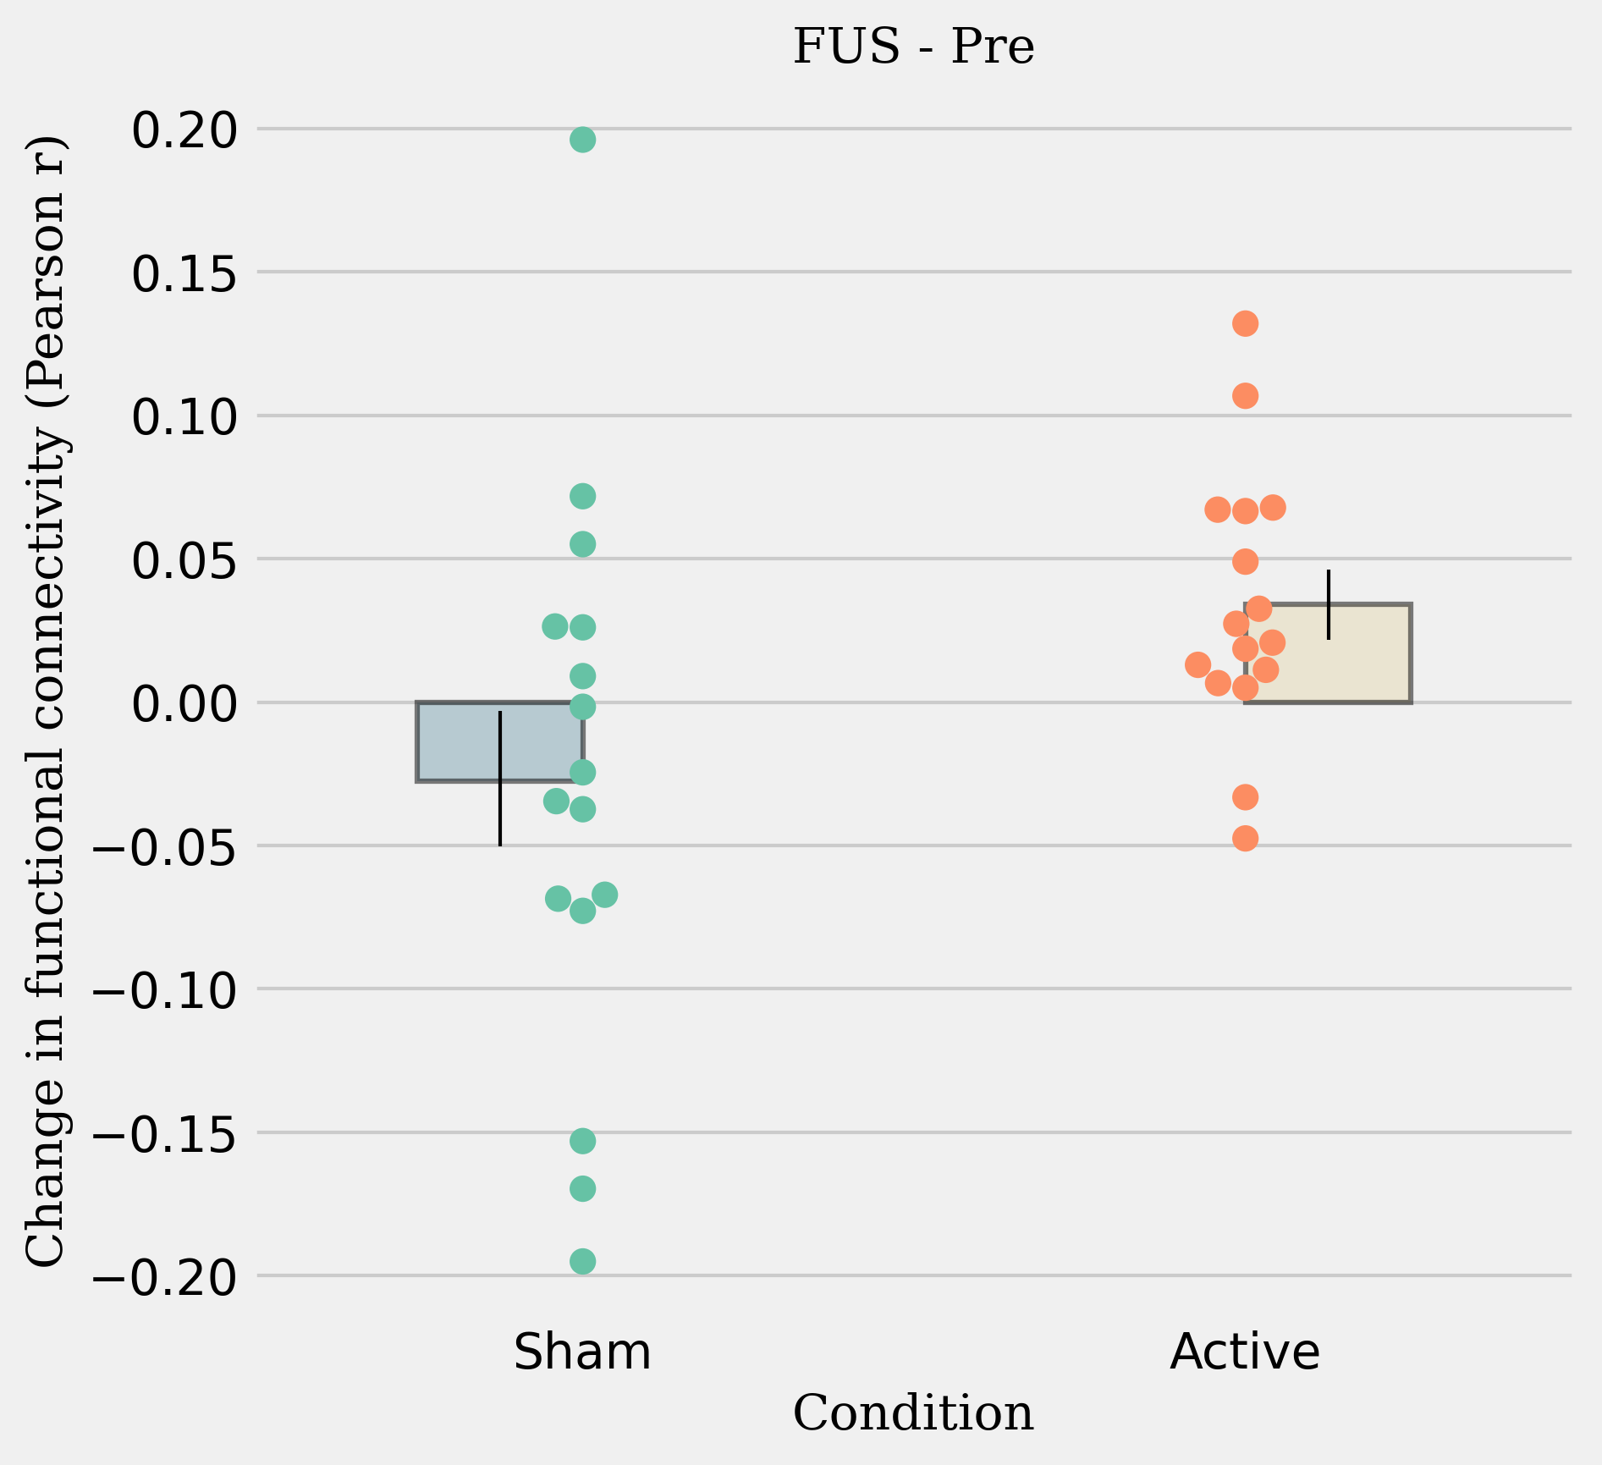
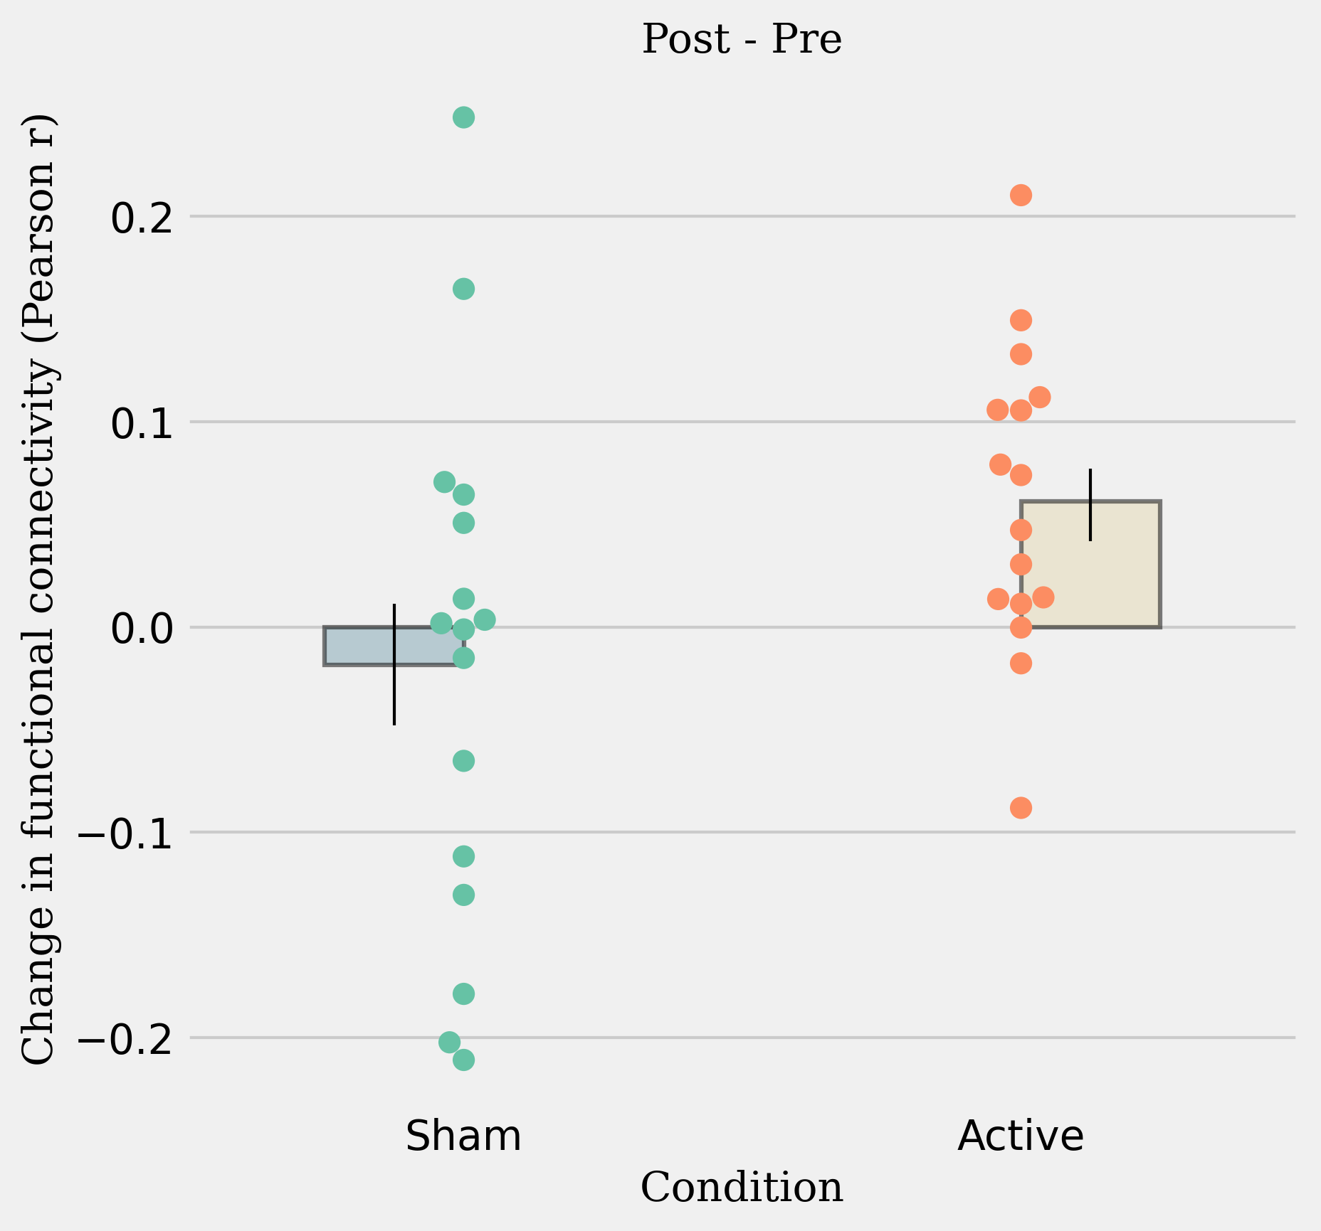
Connectivity with sgACC
Significant increase in connectivity during tFUS (t=2.32, p=0.034, n=16).
Significant increase in connectivity after tFUS (t=2.44, p=0.028, n=16).

Slide 10
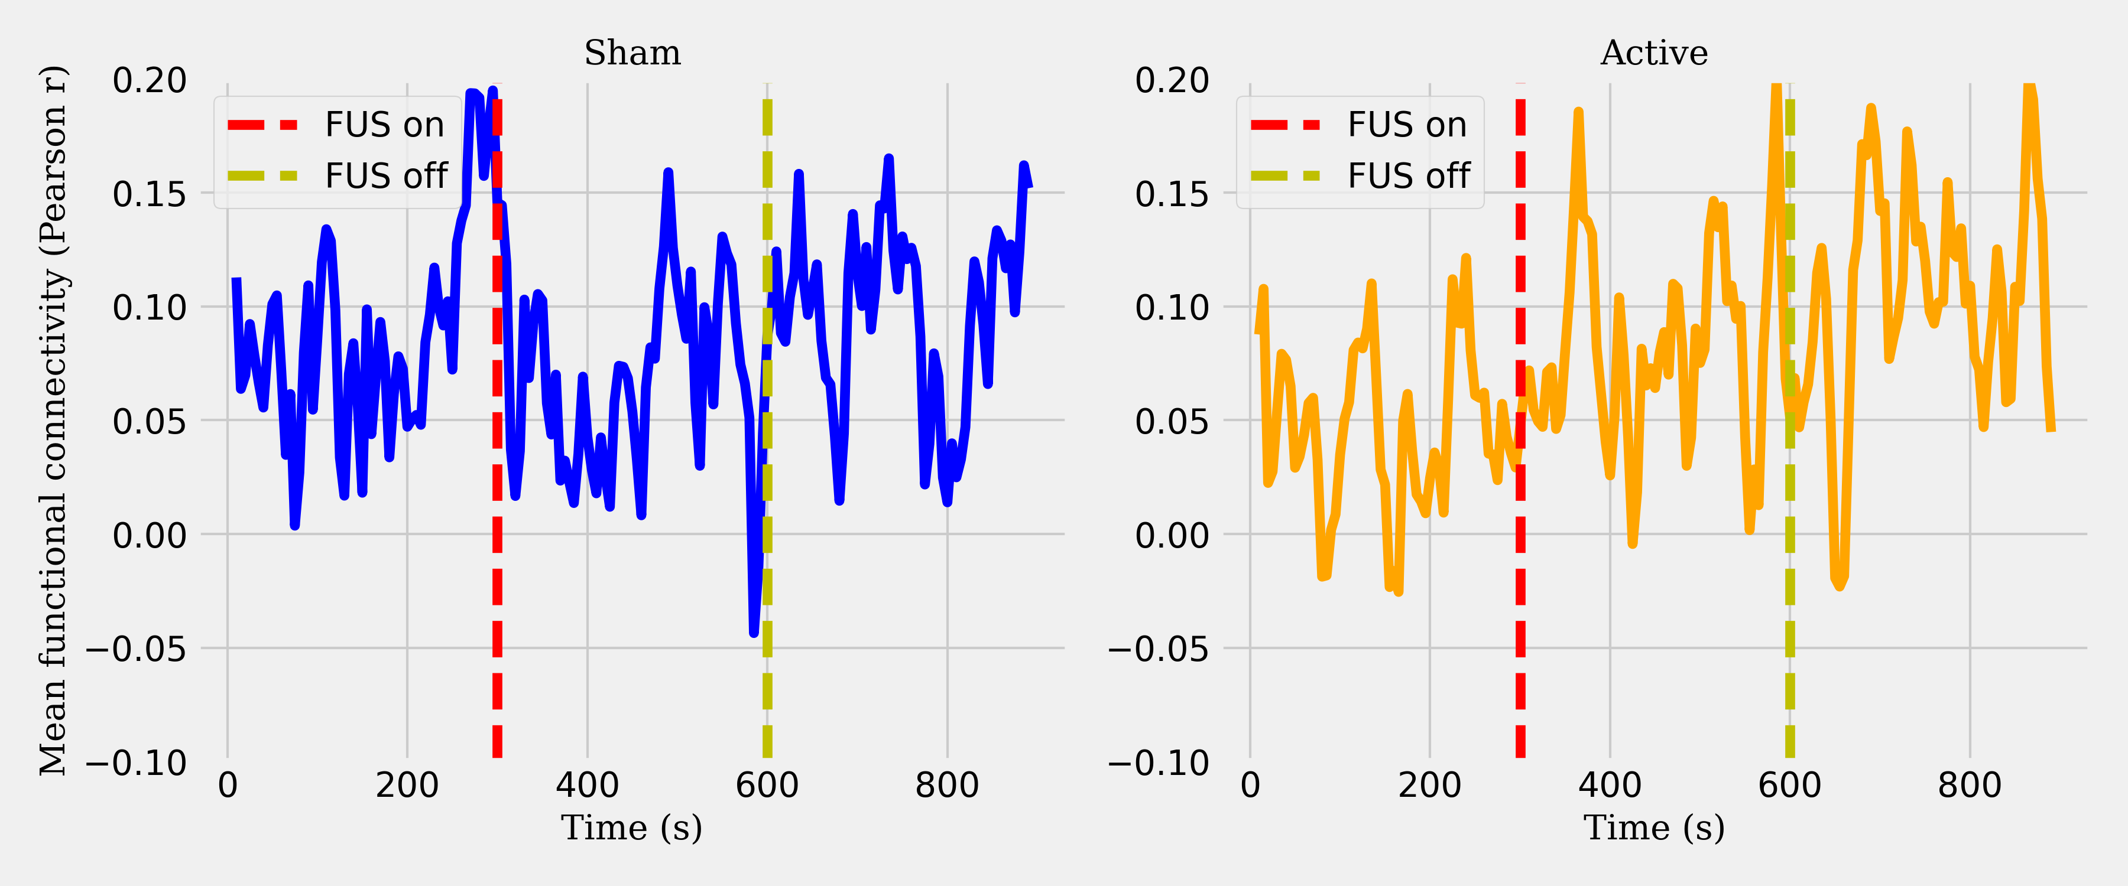
Dynamics of connectivity with sgACC
Time course of functional connectivity shows slow increase.

Slide 11
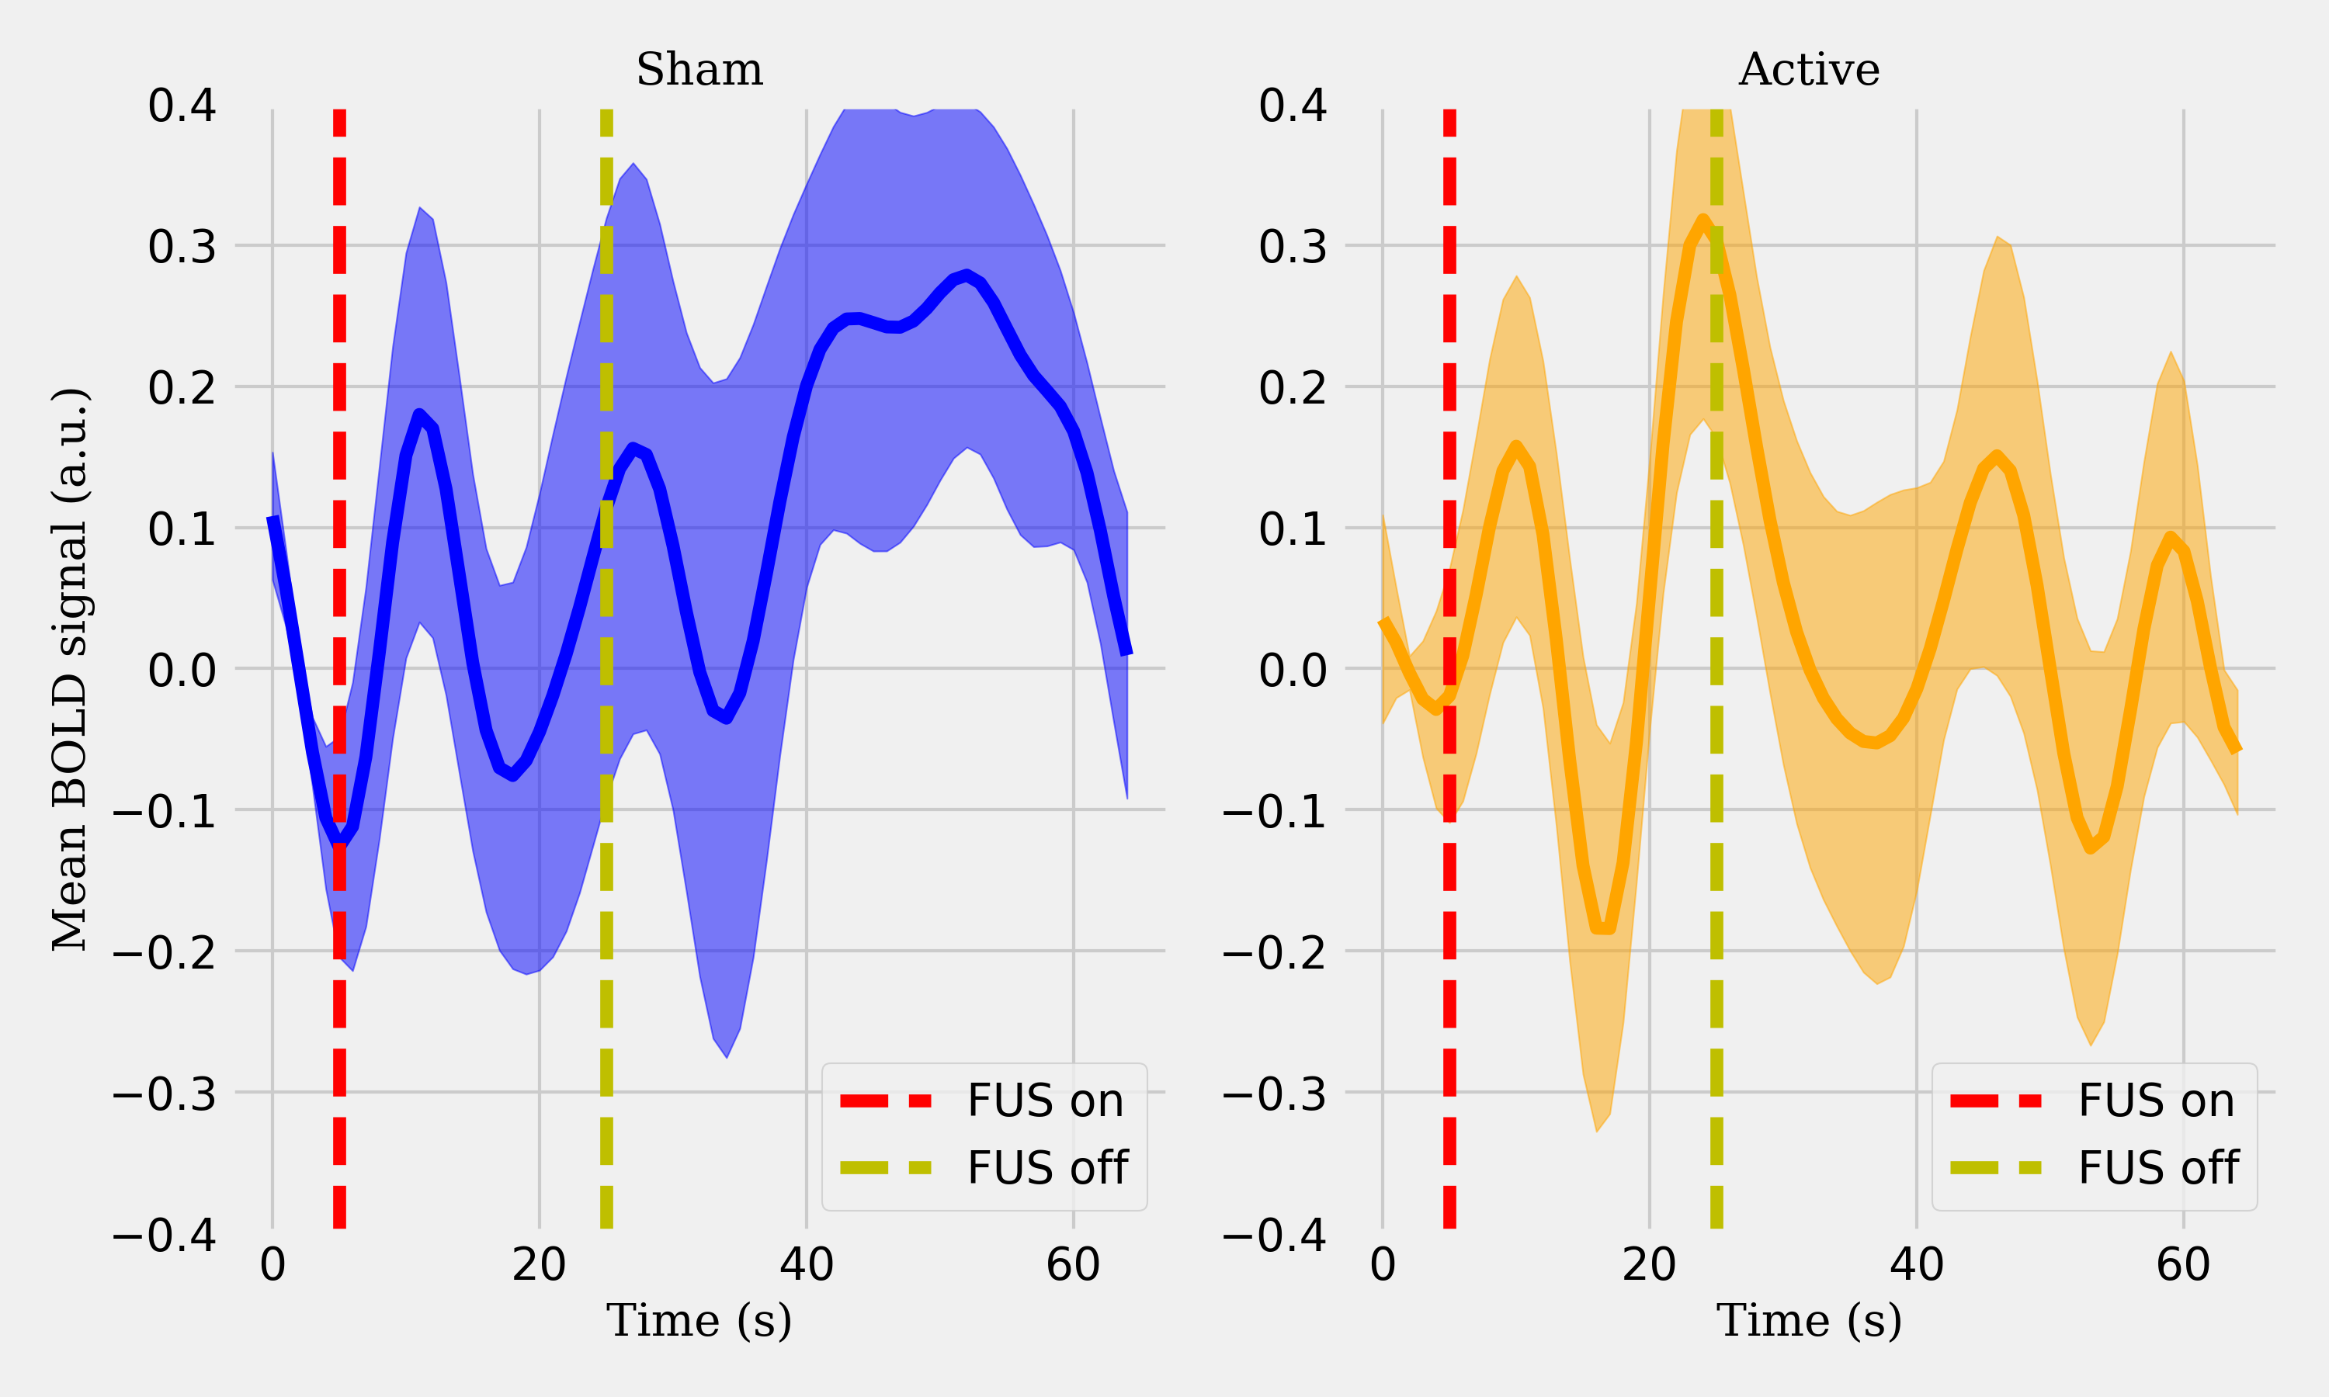
Dynamics of BOLD during sonication
Relative to sham, BOLD signal shows greater amplitude and less variability during sonication. BOLD signal declines immediately following sonication.

Slide 12
Interpretations
What does an increase in connectivity mean?
Increased FC with the sgACC could signify its greater integration into large-scale brain networks:
Default Mode Network (DMN), associated with self-referential thinking and emotional processing
Affective Networks: Enhanced connectivity with limbic and paralimbic structures may imply greater involvement in mood regulation and affective responses.
Increased FC may reflect improved regulation of autonomic or homeostatic functions mediated by the sgACC.
Increased FC indicates enhanced synchrony between local neurons within the sgACC and distant regions.
On a practical level, modulation of subcortical regions is feasible without neuro-navigation and with an “inexpensive” two-element transducer

Slide 13
Acknowledgments
Collaborators
Amilcar Malave
Emily Valera
Duke Shereen
Duc Nguyen
Elisa Konofagou
Chat GPT-o1*
Claude*
Funding
NIH NIDA, NIGMS
* Intelligent non-human agents that contributed to software development, image generation, and fruitful brainstorming sessions

